Slide 1
Graph Analysis
Grab a whiteboard and marker
Provide answer on board
When I put my arm up raise your answer

Slide 2
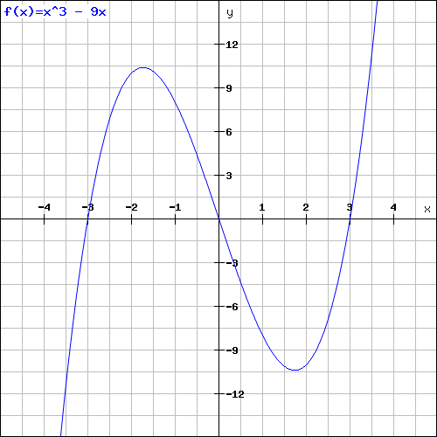
Relative max/min

Slide 3
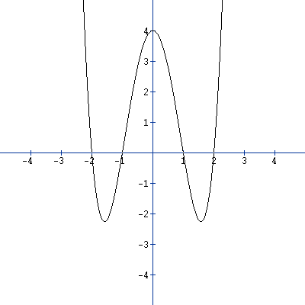
Relative max/min

Slide 4
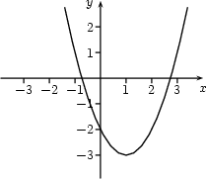
Increasing/Decreasing Intervals

Slide 5
Increasing/Decreasing Intervals

Slide 6
X-intercepts/y-intercepts

Slide 7
X-intercepts/y-intercepts

Slide 8
Positive/Negative Intervals

Slide 9
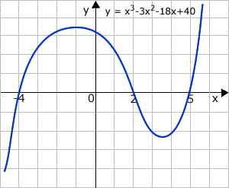
Positive/Negative Intervals

Slide 10
End Behavior (both directions)

Slide 11
End Behavior (both directions)

Slide 12
Homework Time
Open your computer and log into ConnectED
Work on Chapter 1 Review
Suzio: 1-9 (all), 11-17 (odd)
Gembis: p. 61 (odds)

