Slide 1
Incenters and Circumcenters!
Circlin’ up the Triangles!

Slide 2
Incenters
of Triangles!

Slide 3
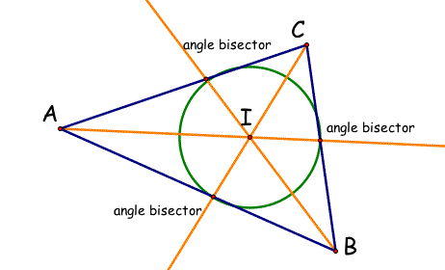
Acute Triangles!

Slide 4
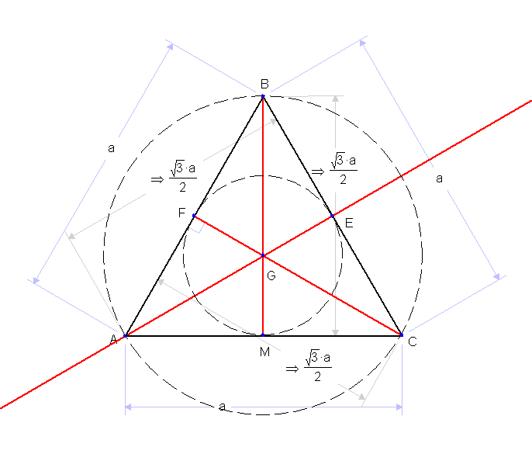
Equilateral Triangles!

Slide 5
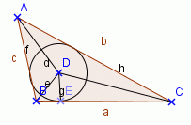
Obtuse Triangles!

Slide 6
Circumcenters
of Triangles!

Slide 7
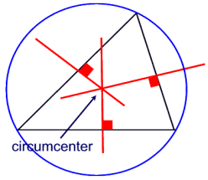
Acute Triangles!

Slide 8
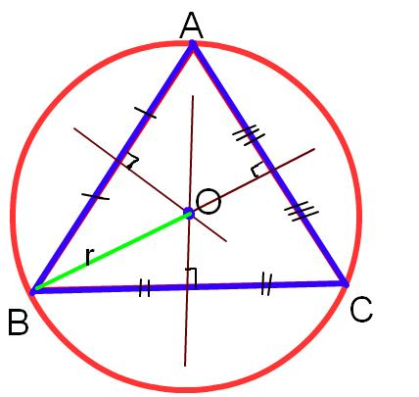
Equilateral Triangles!

Slide 9
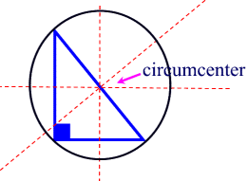
Right Triangles!

Slide 10
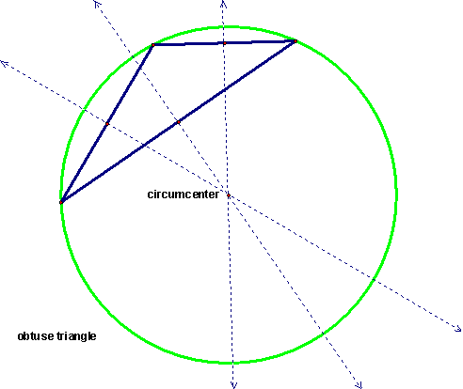
Obtuse Triangles!

Slide 11
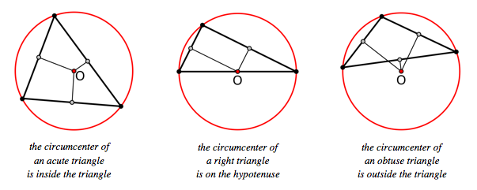
Recap – Location of
Circumcenters on all Triangles!

Slide 12
Incenters and Circumcenters
of Triangles!

Slide 13
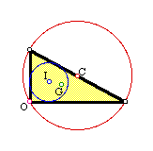
Right Triangles!

Slide 14
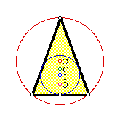
Acute Triangles!

Slide 15
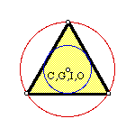
Equilateral Triangles!

Slide 16
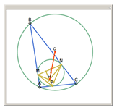
Obtuse Triangles!

