Slide 1
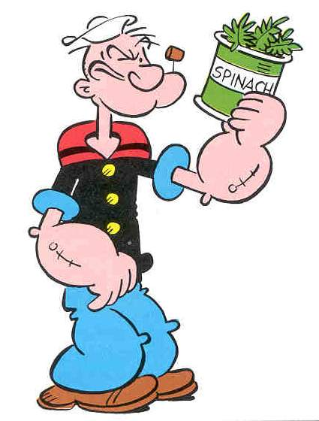
Isolation and Identification of Spinach Pigments
Professor Matt
And Colleen

Slide 2
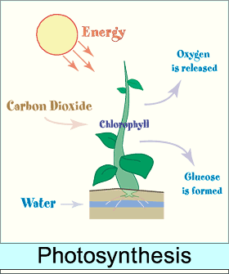
Photosynthesis
Plants and organisms use for food
Requires:
Carbon Dioxide
Water
Sunlight
Highly conjugated pigments
Metal ions

Slide 3
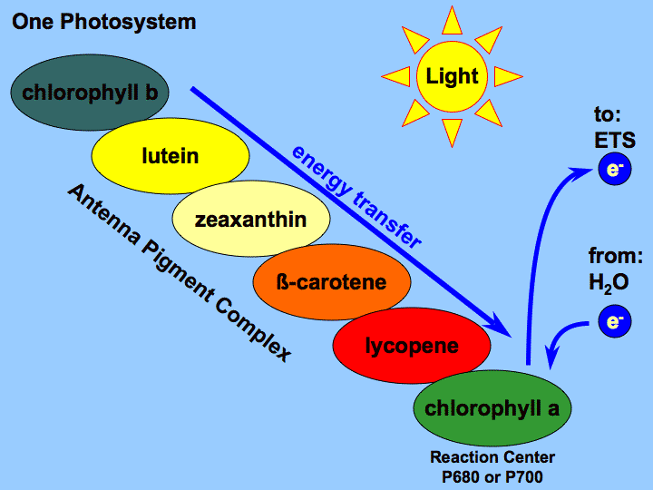
Pigments
Highly conjugated proteins
4 types:
Chlorophyll a
Chlorophyll b
B-carotene
Xanthrophylls violaxanthin
Lutein
Structures provided in lab manual

Slide 4
Chromatography
“color graphing”
Separation using intermolecular forces
Inter = between molecules
Capillary action
IMF strength due to:
Type
Shape
Size

Slide 5
R_{f} value
Calculation using your measurements
Distance moved by a compound, mm
Distance moved by the solvent, mm

Slide 6
Polarity
Based on:
Electronegativity
Molecular weight
Shape/orientation of molecules

Slide 7
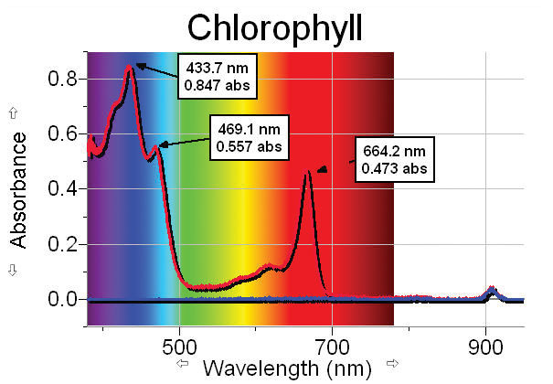
Groups for Absorbency
Group 1: 400-430, 600-640
Group 2: 440-460, 650-690

