Slide 1
Tgir – “Thank goodness I’m Reviewing”
Perpendicular, Parallel, Correlations, Inverses

Slide 2
Find the slope of a line parallel to the line y = 2x - 7
The slope will be 2 since parallel lines have the same slope!

Slide 3
Find the slope of a line perpendicular to the line y = -(4/6)x + 10
The slope will be 6/4 since perpendicular lines have the negative reciprocal of the original slope!

Slide 4
Find the equation of a line parallel to the line y = 2x -7 and through (-3,1)
You can leave it in point-slope form
The equation will be y-1 = 2(x+3)

Slide 5
Find the equation of a line perpendicular of the line y = (1/3)x +1and (6,3)
You can start in point-slope form, but convert to
Slope intercept form!
The equation will be y = -3x + 21

Slide 6
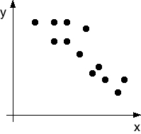
Identify if the function has a positive or negative correlation.
The correlation is negative because the line of best fit will be going down as you move your finger from left to right across the graph.

Slide 7
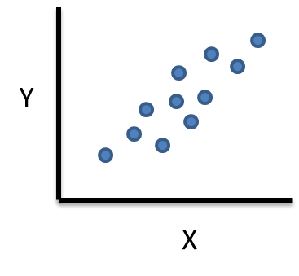
Identify if the function has a positive or negative correlation.
The correlation is positive because the line of best fit will be going up as you move your finger from left to right across the graph.

Slide 8
Identify the inverse of the coordinates: (4, 3), (10, 8), (-3, 6)
Remember when you are taking the inverse you are simply switching the x and y values!!!
(3, 4), (8, 10), (6, -3)

Slide 9
Find the inverse of the function: y = x -4
Remember when you are finding the inverse you are simply switching the x and y values!!!
Start by substituting x for y AND y for x
Next, write in slope-intercept form
Y = x + 4

