Slide 1
Planning Paradise
“Turning your dreams into a reality”

Slide 2
Cover Page
Your proposal should include a quality cover page – sell your blueprint!
For the cover page you must have the following:
Name
Company
Picture
Type of Paradise you are
creating
Room
Resort
Theater

Slide 3
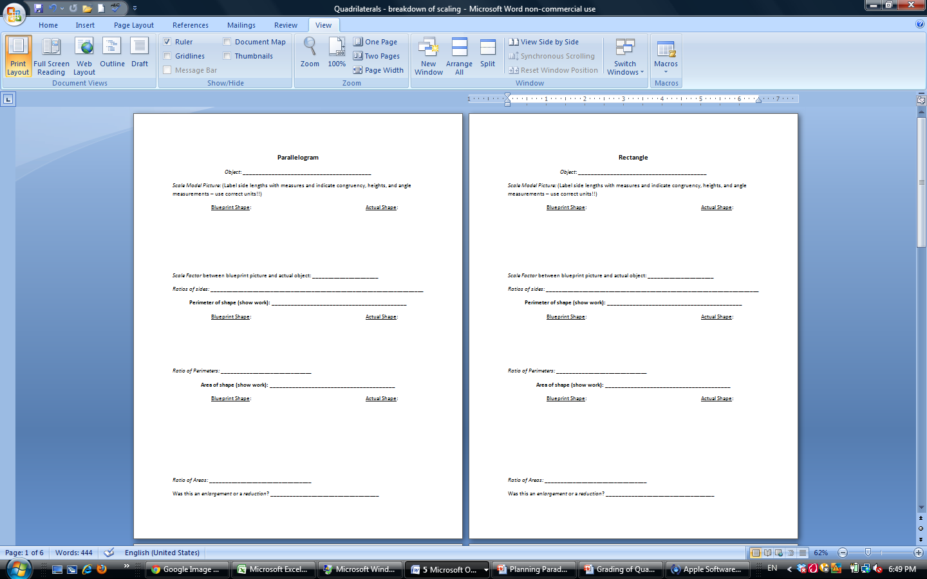
Daily Quadrilateral Sheet

Slide 4
Daily Quadrilateral Sheet
Each day you will be filling out a sheet on a different quadrilateral
For each quadrilateral you
must identify the following:
Object - 1 point
Side Lengths - 2 points
Angle Measures - 2 points
Scale Factor - 1 point
Ratios of Sides - 2 points

Slide 5
Daily Quadrilateral Sheet
Each day you will be filling out a sheet on a different quadrilateral
For each quadrilateral you
must identify the following:
Area - 4 points
Ratio of Areas - 2 points
Perimeter - 4 points
Ratio of Perimeters - 2 points
Enlargement/Reduction - 1 pt

Slide 6
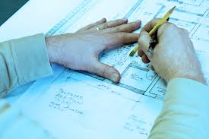
Blueprints
Let’s go through a few examples of blueprints you may be interested in!
Remember for each blueprint you need one of each of the following quadrilaterals:
Parallelogram
Rectangle
Rhombus
Square
Trapezoid
Kite

Slide 7
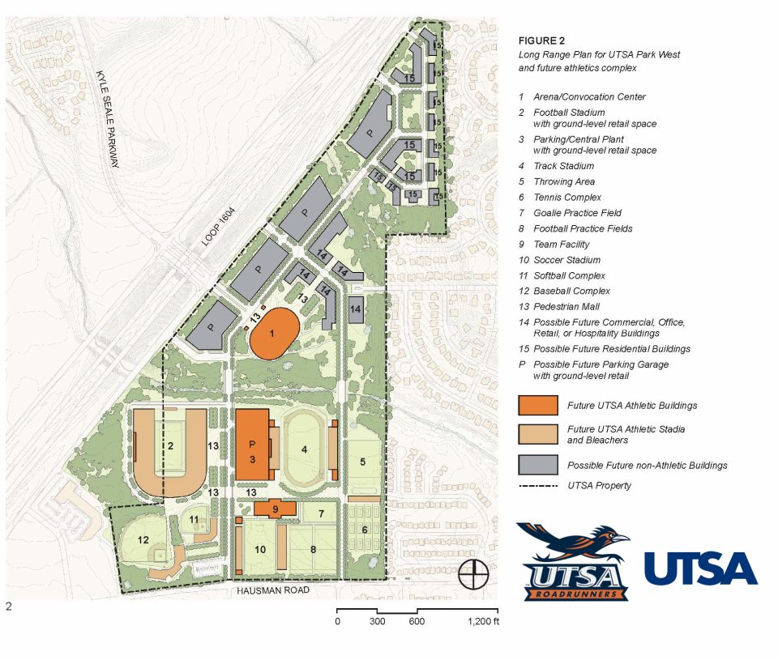
Athletic Complex Blueprint

Slide 8
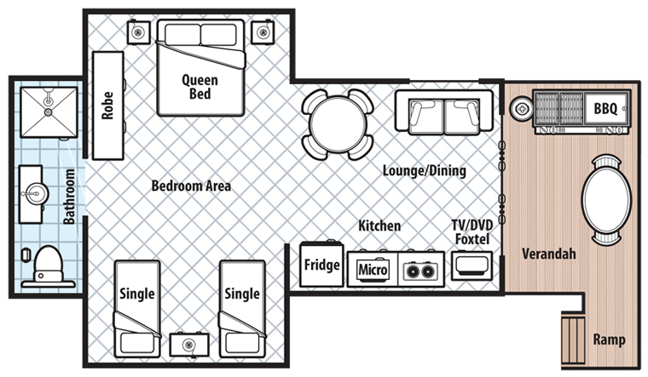
Hotel Room Blueprint

Slide 9
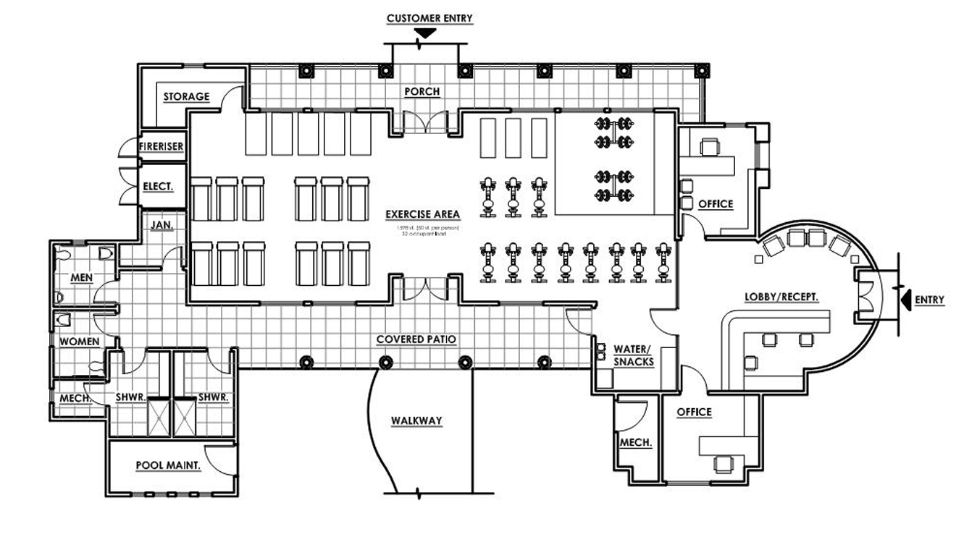
Work Out Facility Blueprint

Slide 10
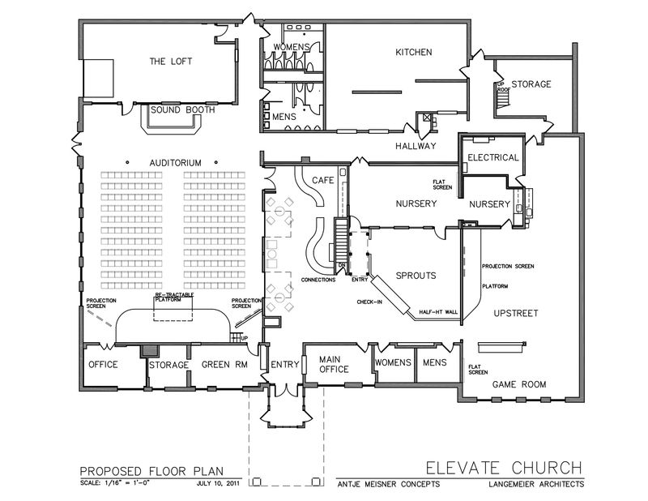
Church Blueprint

Slide 11
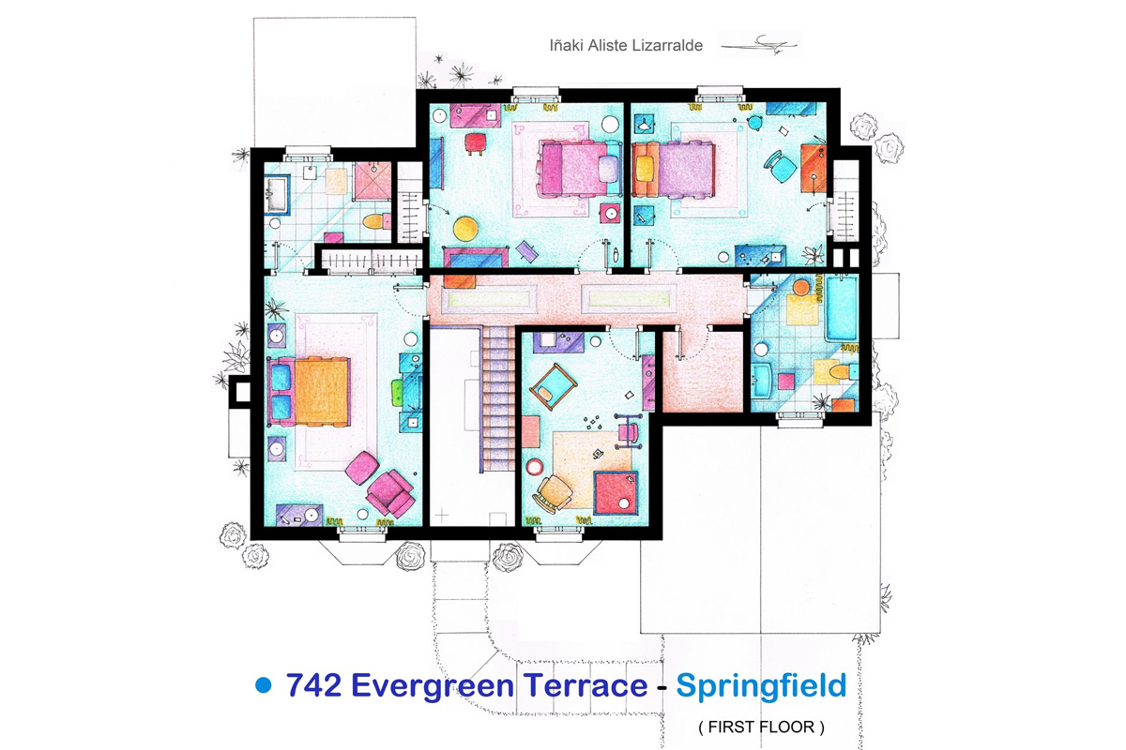
Simpson House Blueprint

Slide 12
Write - Up
Take some time to reflect on this project!
Questions to Answer:
What did you enjoy most about this project?
What would you change?
What was the coolest thing that you learned?
How will you continue to use this information?
Where else could quadrilaterals be used in real life?
Reflection paper needs to be:
Typed, double spaced, no grammar/spelling errors, about 1-2 pages

