Slide 1
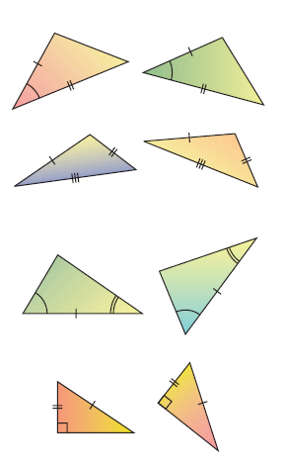
Properties of Triangle Congruence

Slide 2
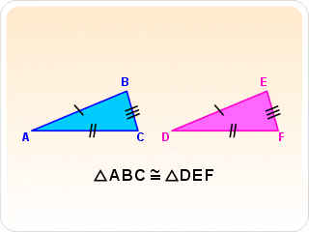
SSS (Side Side Side)
All 3 corresponding sides are equal in length

Slide 3
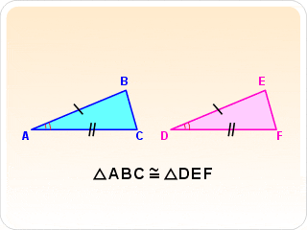
SAS (Side Angle Side)
A pair of corresponding sides and the included angle are equal

Slide 4
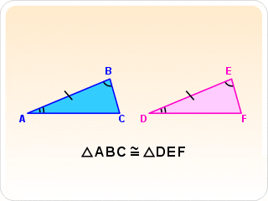
ASA (Angle Side Angle)
A pair of corresponding angles and the included sides are equal

Slide 5
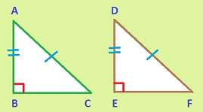
HL (Hypotenuse Leg of Right Triangle)
Two right triangles are congruent if the hypotenuse and one leg are equal

Slide 6
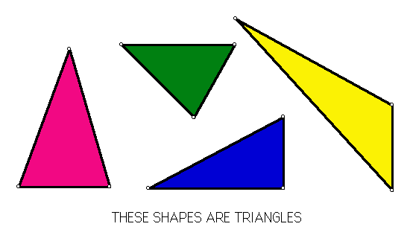
Some Properties DON’T work

Slide 7
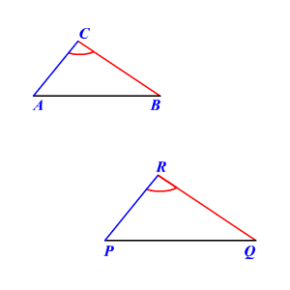
SSA (Side Side Angle)
A pair of adjacent sides and a non-included angle are equal
Possible to draw two different triangles that satisfy the SSA rule, so not possible

Slide 8
AAA (Angle Angle Angle)
All 3 corresponding angles are the same
Triangles will be the same shape, but not necessarily the same size

