Slide 1
Radiation
Unstable, unhealthy, understood

Slide 2
Radioactivity
Spontaneous emission of energy from unstable atoms
Unstable atoms decay and emit radiation
Examples: Uranium, Thorium, Potassium
Naturally occurring radioactive forms
Carbon
Bismuth
Radon
Strontium

Slide 3
Radiation Types
Alpha
Beta
Gamma

Slide 4
Alpha Decay
Heavy, short-range particle
Ejected helium nucleus
2 protons
2 neutrons
mass of 4

Slide 5
Alpha Decay
When nucleus emits an alpha particle
Atomic number decreases by 2
loses 2 protons
Atomic mass decreases by 4
2 neutrons and 2 protons
Can’t penetrate human skin
Examples: radium, radon, uranium, thorium

Slide 6
Beta Decay
Light, short-range particle
Ejected electron - minus 1 charge, very very small mass
Atomic mass unchanged
Atomic number increases by one when beta particle emitted

Slide 7
Beta Decay
Travels several feet in air, moderately penetrating;
Penetrates human skin to "germinal layer," can cause skin injury over time
Pure beta emitters: strontium -90, carbon-14, tritium, sulfur-35

Slide 8
Gamma Decay and X Radiation
Electromagnetic WAVES, no mass or charge
Atomic number and mass unchanged
Highly penetrating electromagnetic radiation
Able to travel many feet in air and inches in human tissue "penetrating" radiation

Slide 9
Gamma Decay and X Radiation
X rays like gamma, still penetrating radiation
Sealed radioactive sources and machines emitting gamma and x radiation = external hazards to humans
Dense materials shield gamma radiation
Examples: iodine-131, cesium-137, cobalt-60, radium-226

Slide 10
Nuclear Fission
Can be spontaneous, but usually initiated in nuclear reactor
Radioactive process: releases LOTS of energy as heavy nucleus is split into two.
can be used to heat water
can be used to generate electricity

Slide 11
Nuclear Fission – What Happens?
Nucleus bombarded w/neutrons
Nuclei of atoms split and release energy and more neutrons
Neutrons hit more nucleuses and do same thing...so much heat released
Nuclear reactor – where occurs
Steam being made produces electricity

Slide 12
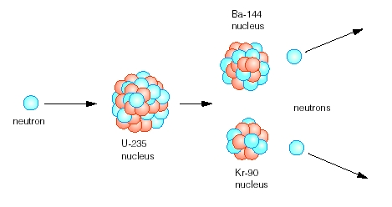
Nuclear Fission - pictorally

Slide 13
Fission visualization
http://library.thinkquest.org/17940/texts/images/fissionanim.gif

Slide 14
Nuclear Fusion
Fusing two nuclei together
Yield of energy b/c mass of the combo less than sum of the masses of the individual nuclei
Deuterium cycle - fusion of deuterium and tritium, requires 40 million K to overcome barrier to ignite it
Deuterium = one neutron, one proton
Tritium = two neutron, one proton
Outer space - creating stars

Slide 15
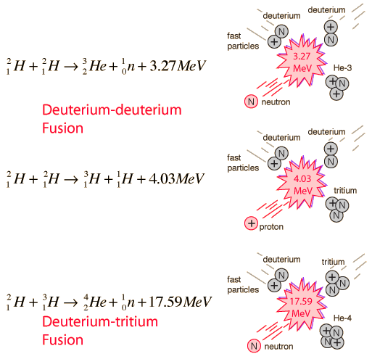
Fusion in pictures

