Slide 1
Review of Line Equations
Answer on whiteboard please
Turn in Chapter 2 Focus Problems/Quiz Corrections on counter!
Pick up 3-3 & 3-4 Concept Organizer on counter!

Slide 2
Guess what guys and gals?

Slide 3
Write an equation in point-slope form

Slide 4
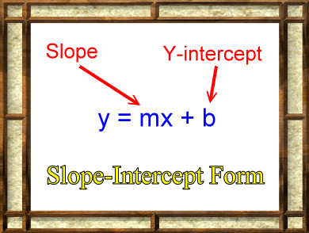
Write an equation in slope-intercept form

Slide 5
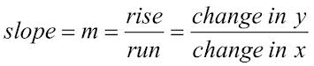
Write the equation for finding the slope of a line through 2 points

Slide 6
Write the point slope equation for a line with a slope of 2 and the point (3,7)

Slide 7
Write the point-slope equation for a line through points (2,8) and (5,20)
Now, convert the equation to slope-intercept form

Slide 8
Write what you are looking forward to most this weekend

Slide 9
Now, begin to work on:
Class Work: Worksheet on 3-3 & 3-4 (on counter)
Have out for grading:
3-3 & 3-4 concept organizer
Anything else you haven’t shown Ms. Condra (p. 176 CW, p. 183 HW, notes from 3-2, etc)
Turn in Chapter 2 Focus Problems/Quiz Corrections on counter
Since it is Homecoming…
Homework: Finish worksheet / no homework

